Slide 1


Deep Learning Models for Gesture-controlled Drone Operation
Tahajjat Begum , Israat Haque, and Vlado Keselj
Computer Science, Dalhousie University, Halifax, Canada

Slide 2
Roadmap
Background on CNN
Methodology
Discussion on Result
Future Research Direction
Conclusions

Slide 3
Objectives
Gesture-controller drone operation is flexible and easy to use.
Design deep learning models for gesture-controlled drone operation.
Develop three deep neural network-based gesture recognition models: Simple CNN, VGG-16, ResNet50.
Our experiment suggests that the simple CNN model offers the best accuracy.
Any of the proposed models can be used in drone applications depending on the available resource and dataset.

Slide 4
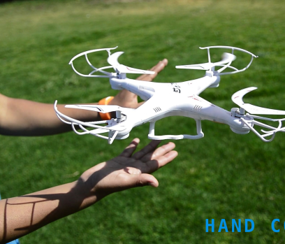
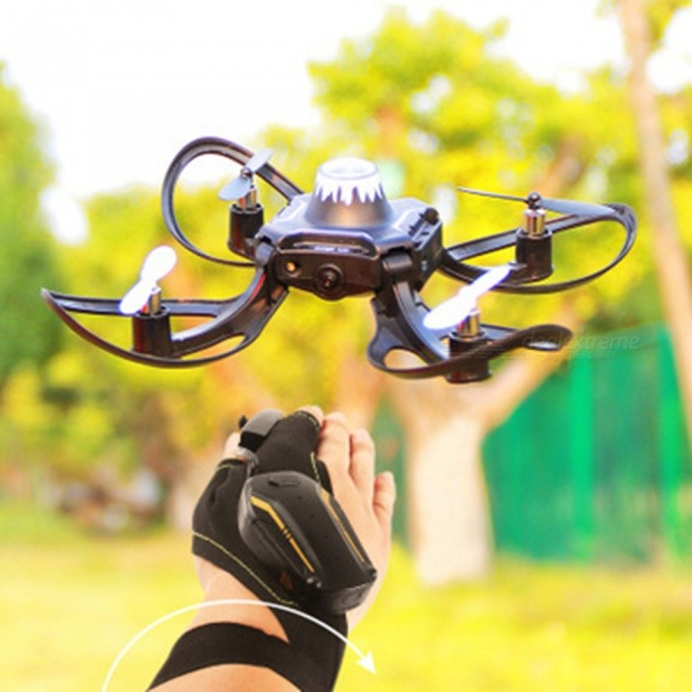
Drone Applications and Usage
Vision-based Navigation
Glove –based Navigation

Slide 5
Drone Applications
Aerial photography – new coverage by media houses
Search and Rescue Operation – can be used in dark and challenging terrain
Agriculture and Farming – monitoring of irrigation
Shipping and Delivery – food order in Pandemic
3D Mapping – airport planning, construction, and maintenance
Military Inspection and Security
Filming and Movies
Entertainment
Mining Applications

Slide 6
Example of a gesture Controlled Drone System

Slide 7
CNN for Image Classification
Widely accepted machine learning algorithm for image processing. We are comparing three architectures: ResNet50, VGG-16, and Simple CNN. The architectures vary in terms of the number of layers.
Different CNN architectures:
LeNet-5
AlexNet
VGG-16
Inception-v1
ResNet-50
Xception
Inception-v4
ResNeXt-50

Slide 8
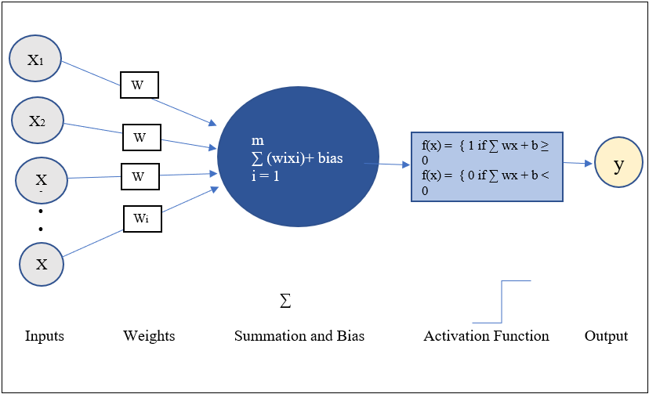
Neural Network Operation

Slide 9

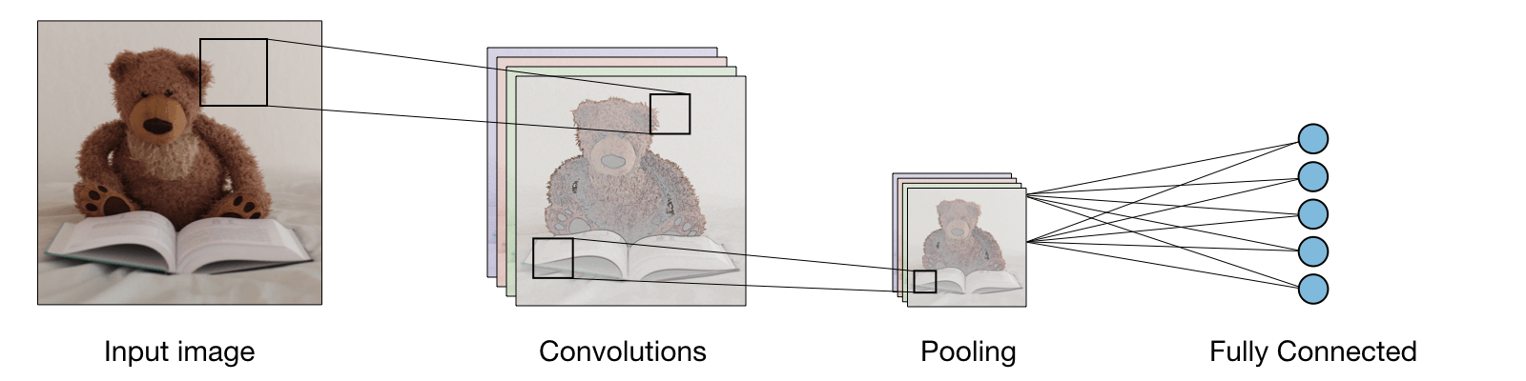
Simple CNN Architecture
Bonner, "The Complete Beginner’s Guide to Deep Learning: Convolutional Neural Networks and Image Classification," towards data science, 2 February 2019. [Online].Available: https://towardsdatascience.com/wtf-is-image-classification-8e78a8235acb. [Accessed 11 April 2020].
S. Saha, “A Comprehensive Guide to Convolutional Neural Networks - the ELI5 way,” Towards Data Science, 17-Dec-2018. [Online]. Available: https://towardsdatascience.com/a-comprehensive-guide-to-convolutional-neural-networks-the-eli5-way-3bd2b1164a53. [Accessed: 20-Apr-2020].

Slide 10

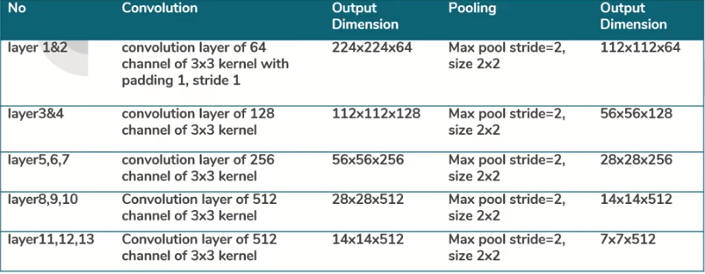
VGG-16 Architecture
S. Tiwari, "CNN Architecture Series — VGG-16 with implementation(Part I)," Data Driven Investor, 25 November 2019. [Online]. Available: https://medium.com/datadriveninvestor/cnnarchitecture- series-vgg-16-with-implementation-part-i-bca79e7db415. [Accessed 20 March 2020].

Slide 11
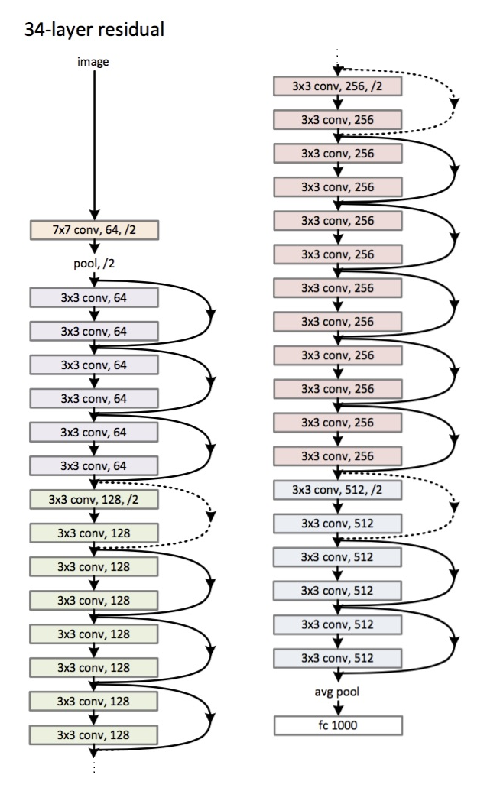
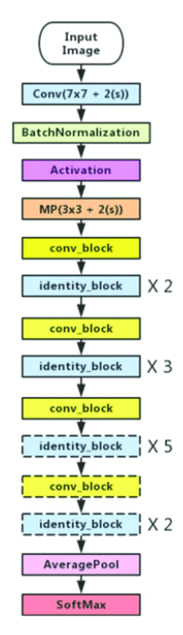
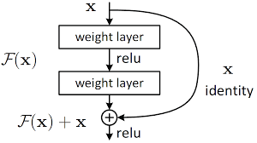
ResNet-50 Architecture
K. He, X. Zhang, S. Ren and J. Sun, "Deep Residual Learning for Image Recognition," in The IEEEconference on computer vision and pattern recognition, Las Vegas, 2016.
Jeremy Jordan, “Common architectures in convolutional neural networks.,” Jeremy Jordan, 20-Oct-2018. [Online]. Available: https://www.jeremyjordan.me/convnet-architectures/. [Accessed: 07-May-2020].

Slide 12
Methodology
Data collection
Data/Image preprocessing
Training of models
Testing of models

Slide 13
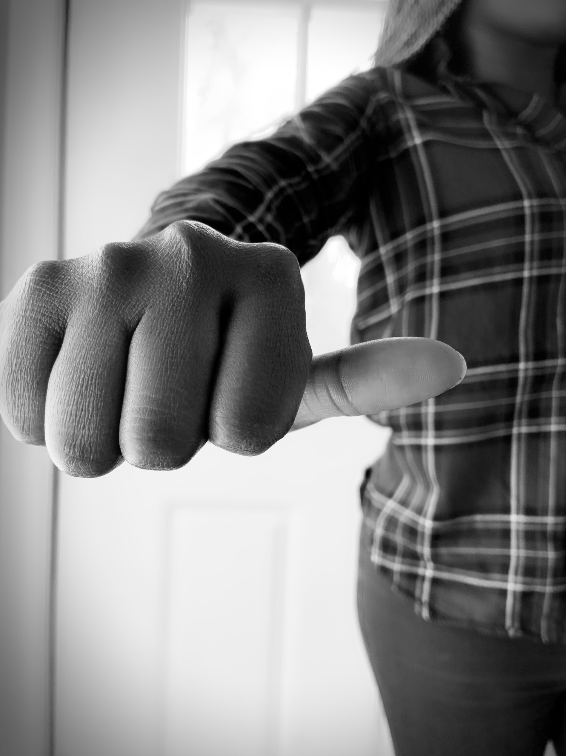
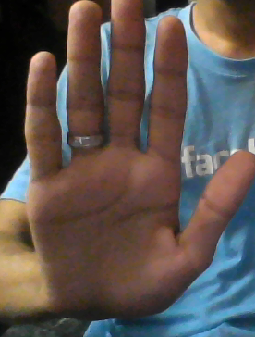
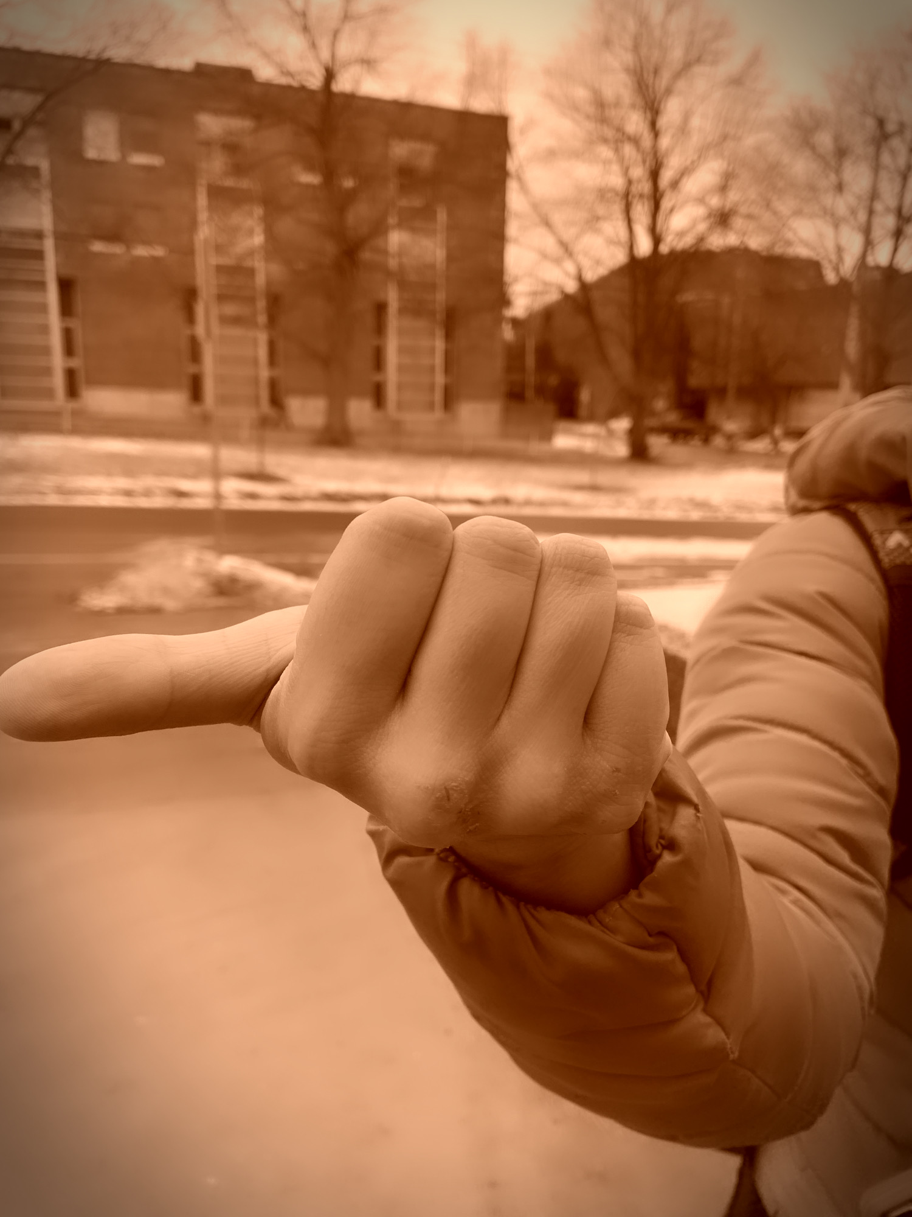
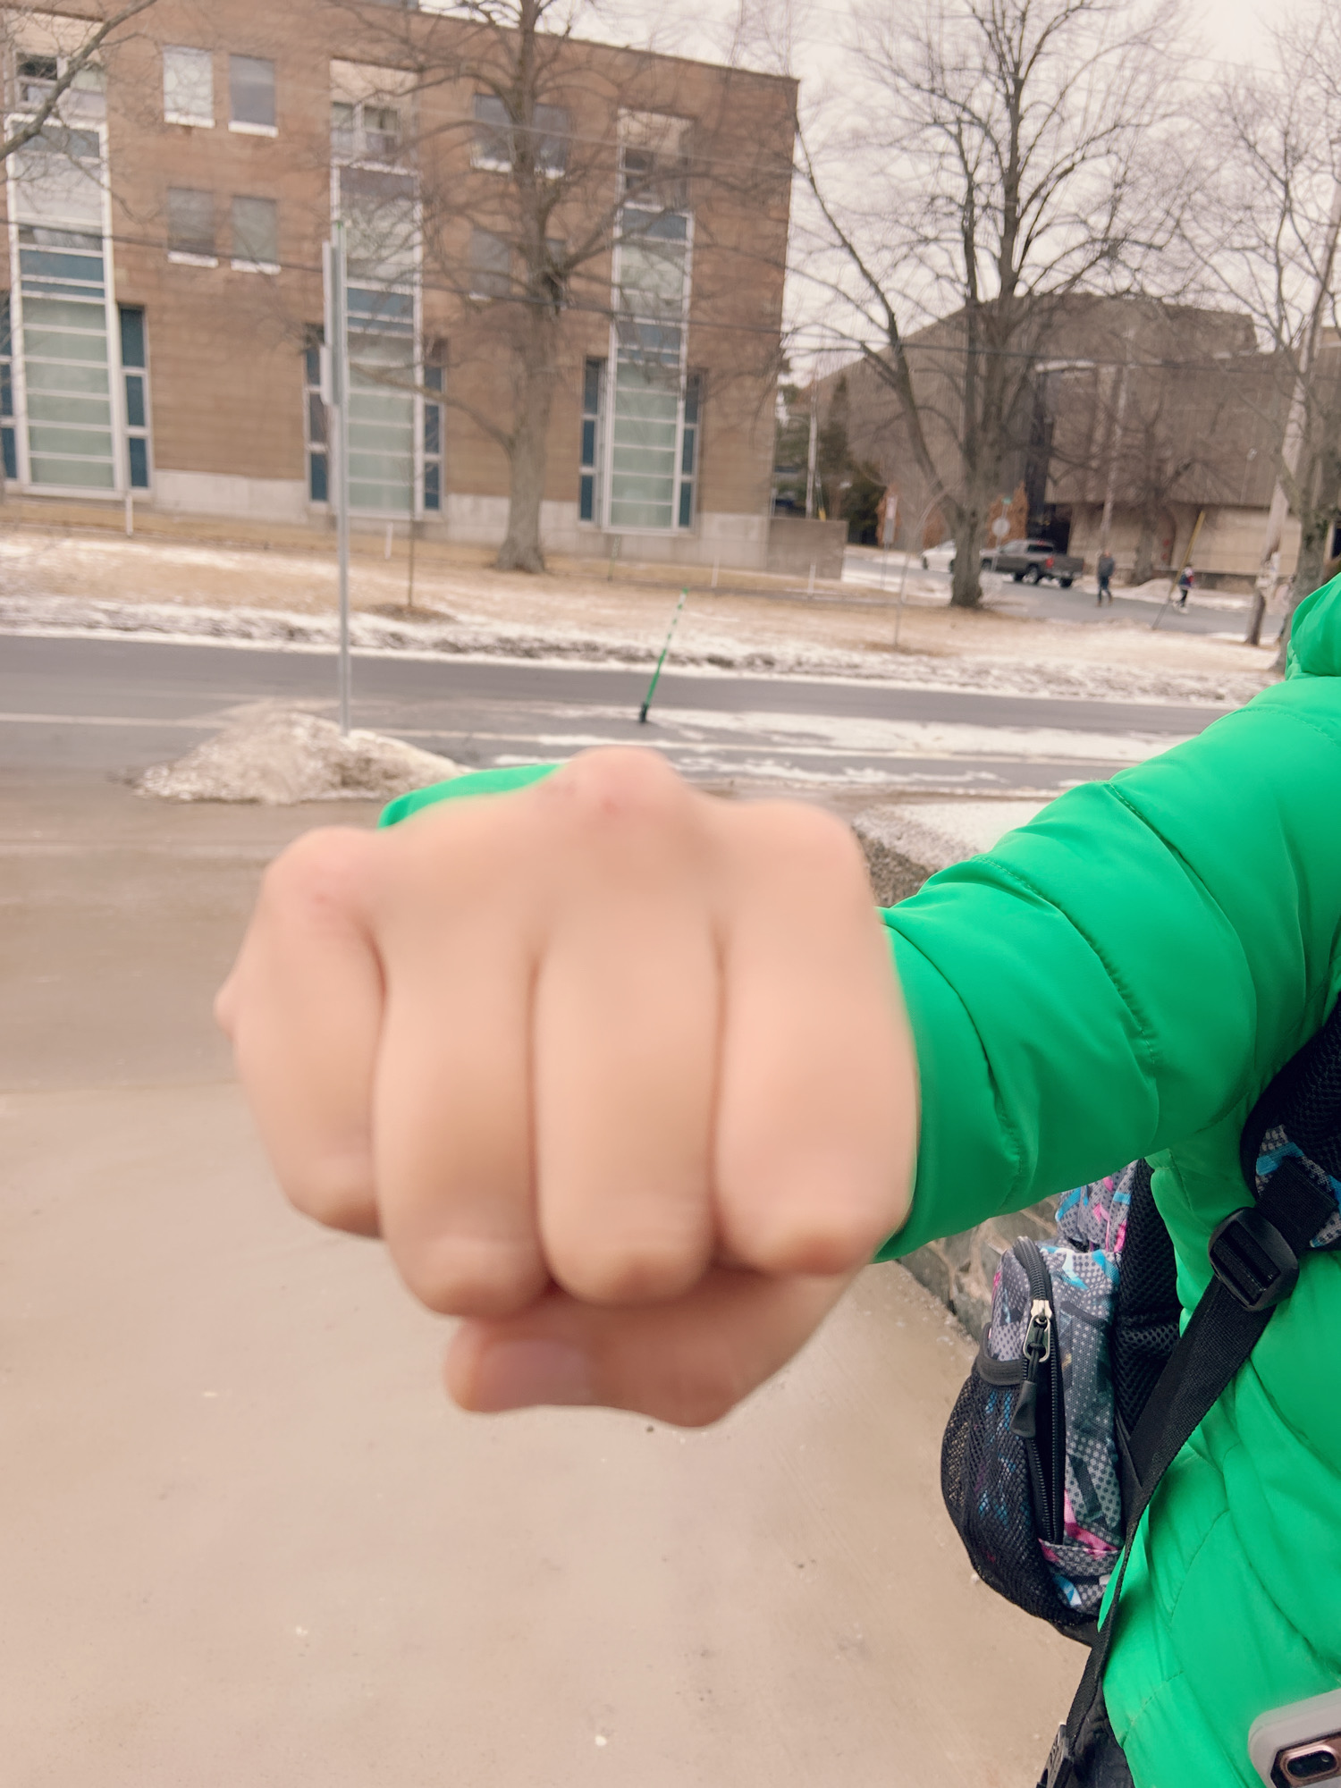
Data Collection and Preprocessing
544 images were captured around Halifax in a different light indoors and outdoors.
17 people participated to provide us 4 gesture images: Stop, Left, Right, and Forward.
Each person provided a total of 32 images in 8 different lights for each gesture.
Mobile and laptop webcams were used to capture images.
Different images were resized into 128X128 pixels as part of the preprocessing.
Images are decomposed into 80% training and 20% testing.
Testing set was completely different from the training set.

Slide 14
Training of Models
In the case of VGG-16 and Resnet-50, we used pretrained models.
We changed the output layer into four classes: right, left, forward, and stop.
We considered a total of 527364 and 34609156 trainable parameters for the VGG-16 and ResNet-50, respectively.
We used Adam optimization algorithm.
In the case of simple CNN, we used Convo2d model with 30 epochs and 32 batch size.
We used a total of 831780 parameters during the training of the simple CNN.
We used rmsprop optimizer algorithm.
We used ReLu activation function for hidden layers and Soft-Max activation function in the final output layer for multiclass problems.
Notes:
We calculated model parameters, epochs, optimizer, number of dense layers, neurons in the dense layers, activation function, and dropout layer to deal with the model overfitting problem.

Slide 15
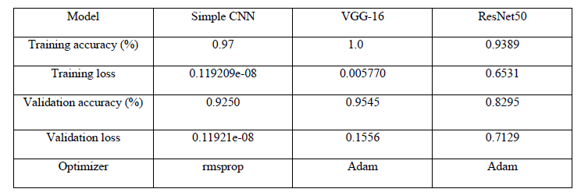
Discussion on Results
Three model comparison in terms of accuracy.

Slide 16
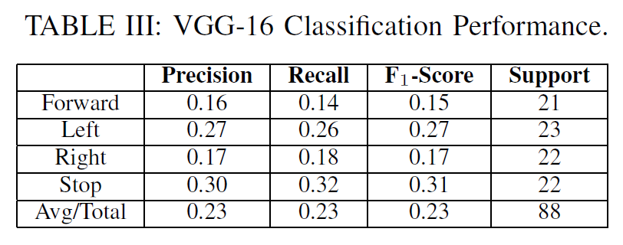
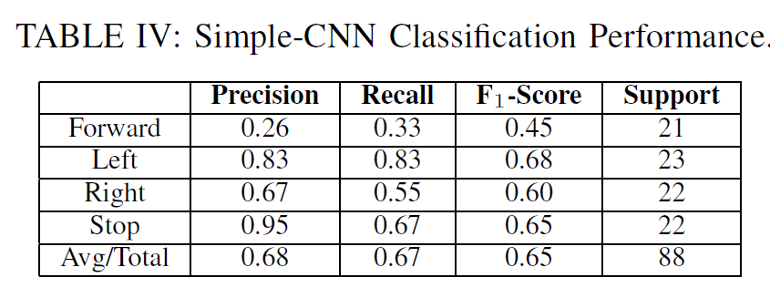
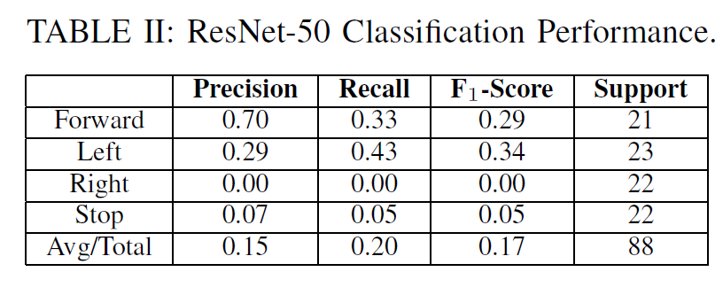
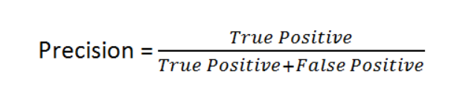
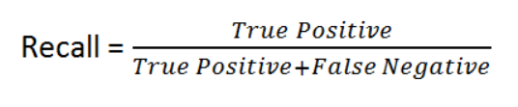
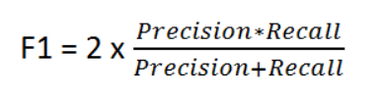
Detailed Results: Gesture Recognition
Comparison of the three models in terms of Precision, Recall, and F1 Value
K. P. Shung, “Accuracy, Precision, Recall or F1?,” Medium, 10-Apr-2020. [Online]. Available: https://towardsdatascience.com/accuracy-precision-recall-or-f1-331fb37c5cb9. [Accessed: 06-May-2020].

Slide 17
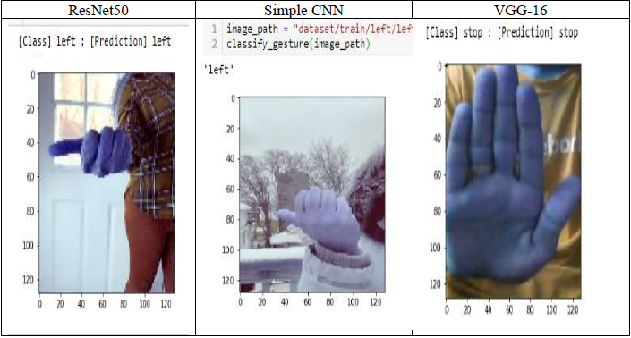
Gesture Recognition
Three different gesture predictions by ResNet, VGG-16, and Simple CNN:

Slide 18
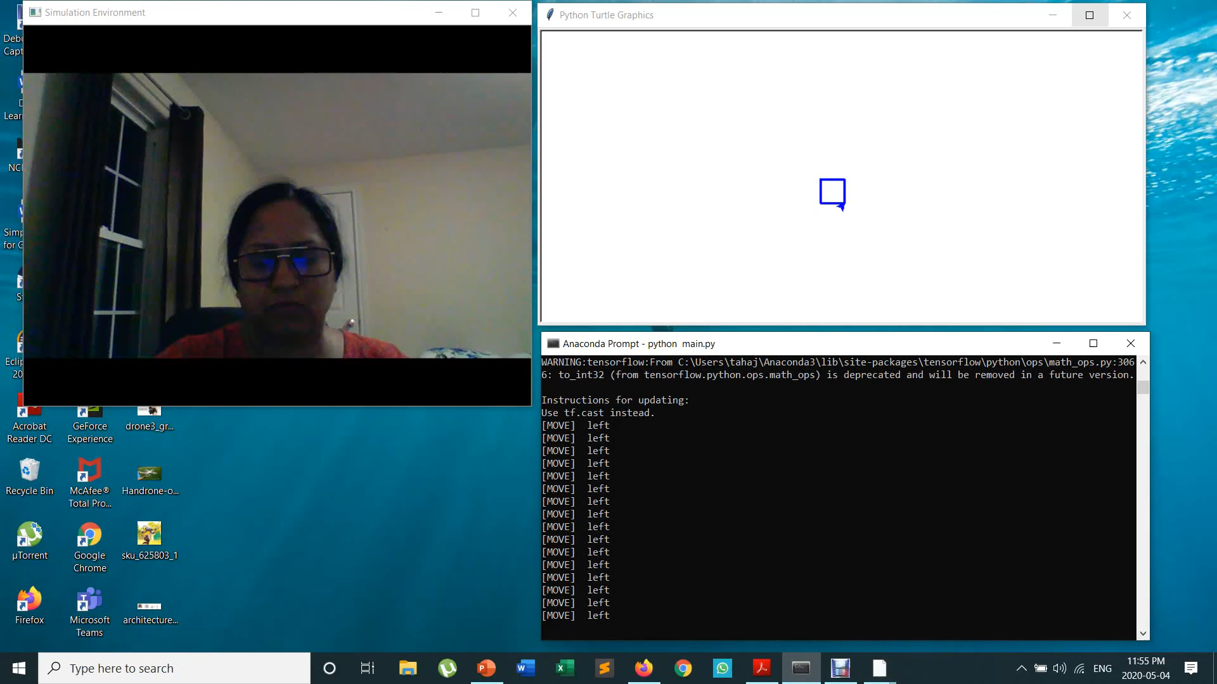
Model Testing in a Simulator
All three models have been tested in Turtle simulator to ensure that the models can recognize gestures.
The webcam was activated using Python library and then gesture recognition models were tested.

Slide 19
Future Work
Dataset:
The current dataset is small; therefore, we plan to generate a bigger dataset using diverse participants.
CNN Based Drone System:
We plan to integrate the proposed gesture recognition model in a simulator and real testbed.
We will use a Parrot A.R Drone, Leap motion controller, and Python interface connection using Olympia.
Drone can be connected using a Raspberry Pi and WiFi network.

Slide 20
Conclusions
Compare different CNN architectures to identify hand gestures: Simple CNN, Resnet, and VGG-16.
Depending on the available resource and dataset, users can choose one of the models.
In the case of a small dataset like ours, simple CNN performs the best.
As part of the future work, we plan to integrate the gesture recognition models in a real drone system.

Slide 21
Reference
A. Bonner, "The Complete Beginner’s Guide to Deep Learning: Convolutional Neural Networks and Image Classification," towards data science, 2 February 2019. [Online].Available: https://towardsdatascience.com/wtf-is-image-classification-8e78a8235acb. [Accessed 11 April 2020].
A. Amidi and S. Amidi, “Convolutional Neural Networks cheatsheet Star,” CS 230 - Convolutional Neural Networks Cheatsheet. [Online]. Available: https://stanford.edu/~shervine/teaching/cs-230/cheatsheet-convolutional-neural-networks. [Accessed: 06-May-2020].
A. Wadhawan and P. Kuman, "Deep learning-based sign language recognition system for staticsigns," Neural Computing and Applications, 2020.
Circuits Today, "Types of Drones – Explore the Different Models of UAV’s," CIRCUITD TODAY, 3February 2017. [Online]. Available: http://www.circuitstoday.com/types-of-drones. [Accessed 28 march 2020].
Ç. Kaymak and A. Uçar, “A Brief Survey and an Application of Semantic Image Segmentation for Autonomous Driving,” Handbook of Deep Learning Applications Smart Innovation, Systems and Technologies, pp. 161–200, Feb. 2019.
D. Joshi, "Drone technology uses and applications for commercial, industrial and military drones in2020 and the future," Business Insider, 18 Dec 2018. [Online]. Available:https://www.businessinsider.com/drone-technology-uses-applications. [Accessed 12 March 2020].
K. He, X. Zhang, S. Ren and J. Sun, "Deep Residual Learning for Image Recognition," in The IEEEconference on computer vision and pattern recognition, Las Vegas, 2016.
K. P. Shung, “Accuracy, Precision, Recall or F1?,” Medium, 10-Apr-2020. [Online]. Available: https://towardsdatascience.com/accuracy-precision-recall-or-f1-331fb37c5cb9. [Accessed: 06-May-2020].
P. Cohn, A. Langstaff and M. Roller, "Commercial drones are here: The future of unmanned aerial systems," Mckinsey, December 2017. [Online]. Available: https://www.mckinsey.com/industries/capital-projects-and-infrastructure/ourinsights/commercial-drones-are-here-the-future-of-unmanned-aerial-systems. [Accessed 02 April 2020].
P. Mishra, "Why are Convolutional Neural Networks good for image classification?," medium, 27 May 2019. [Online]. Available: https://medium.com/datadriveninvestor/why-are-convolutionalneural-networks-good-for-image-classification-146ec6e865e8. [Accessed 11 April 2020].
N. Kang, "Introducing Deep Learning and Neural Networks — Deep Learning for Rookies (1),"Towards Data Science, 18 06 2017. [Online]. Available: https://towardsdatascience.com/introducing-deep-learning-and-neural-networks-deep-learningfor-rookies-1-bd68f9cf5883. [Accessed 22 03 2020].
S. Saha, “A Comprehensive Guide to Convolutional Neural Networks - the ELI5 way,” Towards Data Science, 17-Dec-2018. [Online]. Available: https://towardsdatascience.com/a-comprehensive-guide-to-convolutional-neural-networks-the-eli5-way-3bd2b1164a53. [Accessed: 20-Apr-2020].
S. Tiwari, "CNN Architecture Series — VGG-16 with implementation(Part I)," Data Driven Investor, 25 November 2019. [Online]. Available: https://medium.com/datadriveninvestor/cnnarchitecture- series-vgg-16-with-implementation-part-i-bca79e7db415. [Accessed 20 March 2020].
Ultraleap Ltd, "How Does the Leap Motion Controller Work?," Ultraleap, 2014 august 2014.[Online]. Available: http://blog.leapmotion.com/hardware-to-software-how-does-the-leapmotion-controller-work/. [Accessed 5 april 2020].

